Slide 1

How Utah’s Population Change Has Affected Utah’s Workforce
By: Spencer Duke, Joshua Mayo, Christopher McCormick
Notes:
Christopher:
Introduce topic and how we decided to focus on it.
Wanted to focus on something relevant to us -> We all live in Utah -> Began talking about news articles in regard to Utah’s growing population -> From there, we began looking into housing market data -> discovered workforce/industry data in the process -> ultimately decided on that for our topic.

Slide 2
Our Questions
How much has Utah’s overall population and workforce changed?
How has the growth in population affected our employment-to-population ratio?
Has the population growth had a positive or negative impact on the industry sectors?
Notes:
Christopher

Slide 3

Define Our Parameters
Utah Department of Workforce Services
Industry Data: https://jobs.utah.gov/jsp/utalmis/#/industry
Population Data: https://jobs.utah.gov/jsp/utalmis/#/population
Timeframe:
Beginning 2017 - End 2021 (5 full years)
Notes:
Christopher

Slide 4

How we cleaned our data…
(see Jupyter Notebook)
Notes:
(JOSH)
We will cover how we imported, combined, and cleaned the our data sets.

Slide 5

Population Analysis
Notes:
(SPENCER) We will cover how we imported, combined, and cleaned the our data sets.

Slide 6
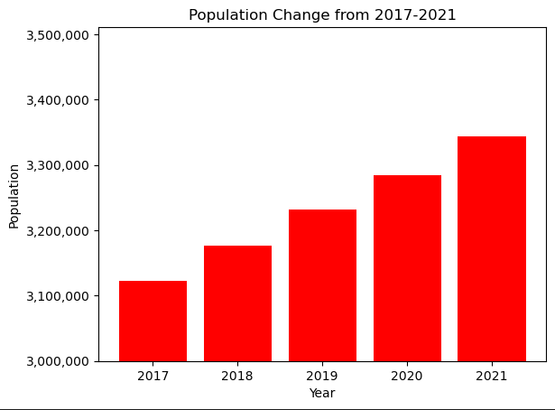
Utah’s Population
Utah’s Population:
End of 2016: 3,116,384
2017: 3,122,477
2018: 3,176,342
2019: 3,231,108
2020: 3,284,832
2021: 3,343,552
Total Population increase of 7.08% between 2017 and 2021
Notes:
(SPENCER)

Slide 7
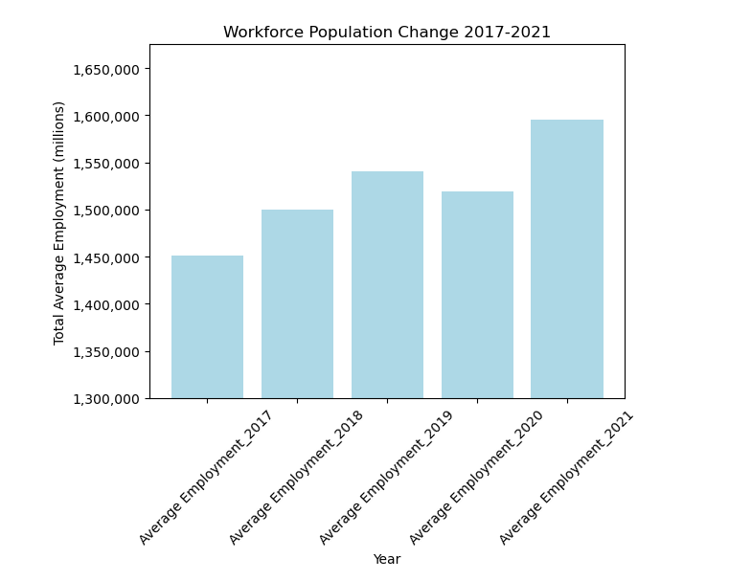
Workforce Population Change
Average employment for 2017 1,477,141
Average employment for 2018
1,495,651
Average employment for 2019 1,535,951
Average Employment for 2020 1,514,918 (COVID Year)
Average Employment for 2021 1,590,734
There was a 7.7% increase in average employment from 2017 to 2021
Notes:
(Spencer)

Slide 8

How we did that…
(see Jupyter Notebook)
Notes:
(Spencer)

Slide 9

Employed Population Analysis
Notes:
(Spencer)
We will cover how we imported, combined, and cleaned the our data sets.

Slide 10

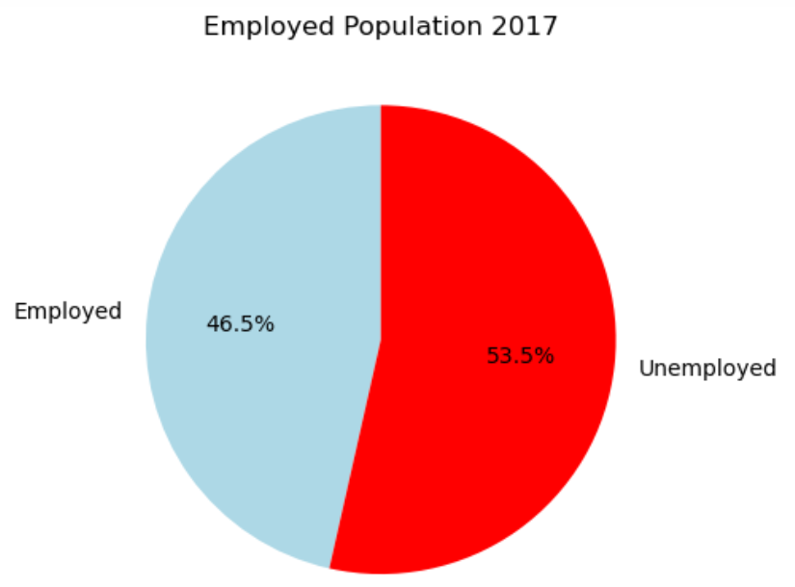
Employment-to-population ratio 2017
2017
Employed: 1,496,465 Pop: 3,122,477
46.5% employed
Notes:
(Spencer)

Slide 11
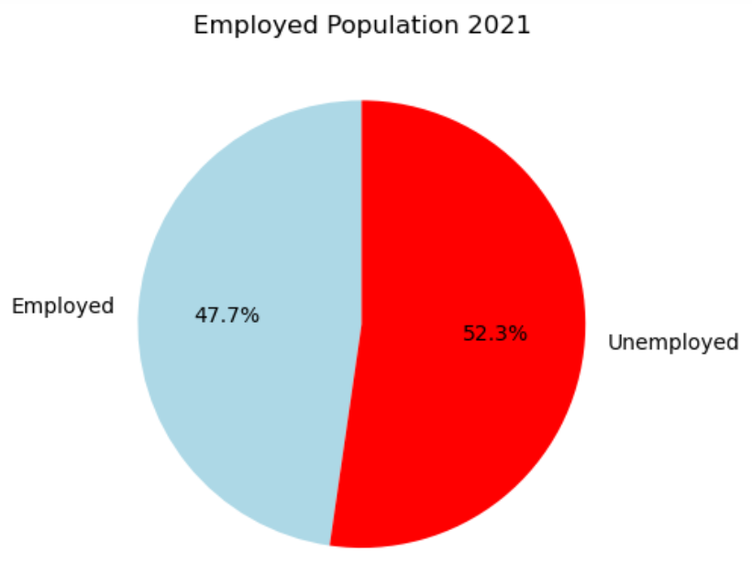
Employment-to-population ratio 2021
2021
Employed: 1,636,150 Pop: 3,343,552
47.7% employed
Notes:
(Spencer)

Slide 12
How we did that…
(see Jupyter Notebook)
Notes:
(Spencer)

Slide 13

Industry Analysis
Notes:
(JOSH)
We will cover how we imported, combined, and cleaned the our data sets.

Slide 14
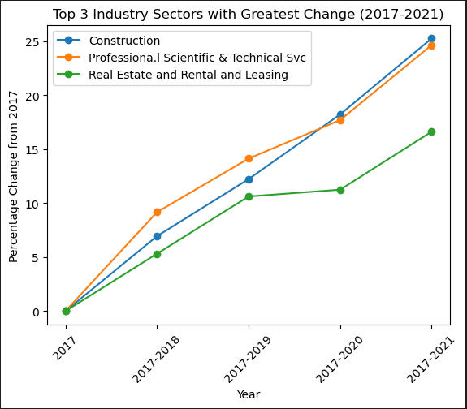
How the top 3 industry sectors have changed
Construction
2017-2018 6.94% increase
2017-2019 12.21% increase
2017-2020 18.21% increase
2017-2021 25.25% increase
Real Estate and Rental and Leasing
2017-2018 9.16% increase
2017-2019 14.12% increase
2017-2020 17.69% increase
2017-2021 24.63% increase
Professional Scientific & Technical Services
2017-2018 5.31% increase
2017-2019 10.61% increase
2017-2020 11.24% increase
2017-2021 16.61% increase
Notes:
(JOSH)

Slide 15
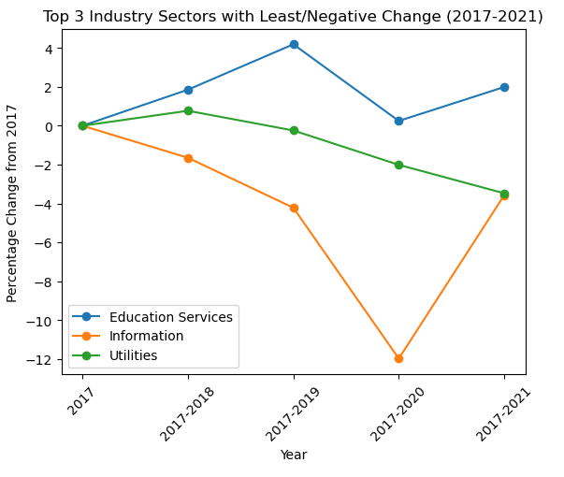
How the bottom 3 industry sectors have changed
Educational Service
2017-2018 1.85% increase
2017-2019 4.18% increase
2017-2020 0.24% decrease
2017-2021 1.99% increase
Utilities
2017-2018 0.77% increase
2017-2019 -0.24% decrease
2017-2020 -2% decrease
2017-2021 -3.47% decrease
Information
2017-2018 -1.64% decrease
2017-2019 -4.21% decrease
2017-2020 -11.97% decrease
2017-2021 -3.56% decrease
Notes:
(JOSH)

Slide 16
How we did that…
(see Jupyter Notebook)
Notes:
(JOSH)

Slide 17

Final Analysis
Notes:
(JOSH)

